Slide 1
CMOS Logic Design
  Fundamentals and Steps
  CMOS logic uses pairs of NMOS and PMOS transistors in a complementary arrangement.
  For a desired function (e.g., using inputs A, B, C, D, and their complements), start by expressing the function as a sum-of-products (SOP) or product-of-sums (POS).
  The NMOS pull-down network realizes the function directly (SOP terms series, parallel); the PMOS pull-up network implements the logical complement (dual POS; parallel and series reversed).
  Connect NMOS sources to ground, drains to output; PMOS sources to VDD, drains to output. Gates receive the required logic inputs.
Merit
  Full rail-to-rail output swing, zero static power dissipation in steady-state.
  High noise margin, robust for digital ICs.
  Power efficient—significant only during switching.
Demerit
  Larger transistor count compared to other styles for complex functions.
  The layout area and capacitance are high, limiting speed in dense circuits.

Slide 2
Pseudo-NMOS Logic Design
Fundamentals and Steps
  Pseudo-NMOS uses a full NMOS pull-down network but only one always-on PMOS as pull-up.
  Build the NMOS logic network for the desired function as in CMOS.
  Connect the single PMOS to VDD and output, permanently enabled.
  The output is pulled high when NMOS is off; pulled down through NMOS stack when function evaluates true.
Merit
  Lower transistor count, saving area and simplifying layout.
  Faster operation for certain gates due to fewer PMOS transistors and smaller output capacitance.
Demerit
  Not full CMOS; static power dissipation occurs when NMOS and PMOS conduct simultaneously.
  Weaker logic '1', reduced noise margin.
  Not suitable for low-power or noise-sensitive designs

Slide 3
DCVSL (Differential Cascode Voltage Switch Logic)
Fundamentals and Steps
  DCVSL creates a differential output using complementary NMOS stacks (for F and ‾F).
  Each output node is connected by its own stack to ground but cross-coupled for feedback with inverters.
  Both stacks are activated by complementary inputs; only one output is pulled low, the other remains high.
  Cross-coupling enhances speed and robustness, creates push-pull outputs.
Merit
  Very fast switching, suitable for high-speed data paths.
  Differential operation enables lower single-ended noise susceptibility and higher circuit speed.
Demerit
  Higher complexity, more transistors, and wiring for cross-coupling.
  Increased dynamic power from toggling both outputs.
  Less area efficient for low-speed or dense logic blocks.

Slide 4
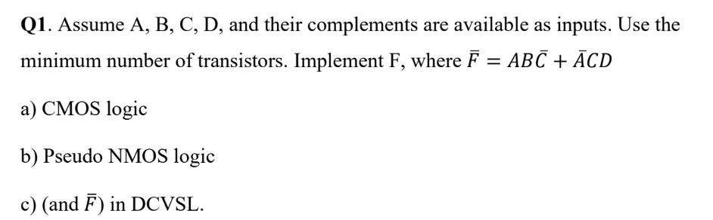
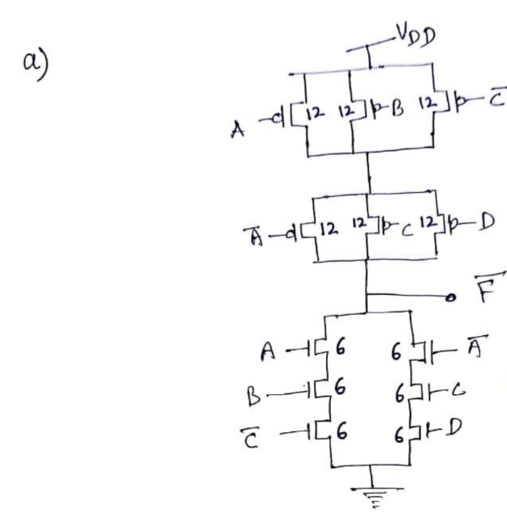
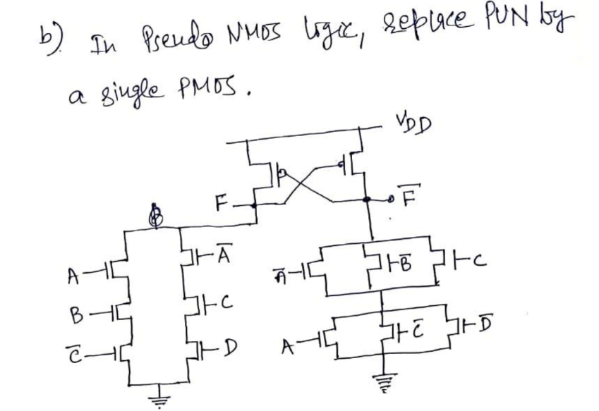
(c)

Slide 5
Summary Table: Logic Family Comparison
Design Style | Steps | Merit | Demerit
CMOS | SOP/POS build; dual networks | High noise margin, no static power | More devices, larger area
Pseudo-NMOS | SOP network; single PMOS load | Fewer devices, faster | Static power, lower noise margin
DCVSL | Dual stacks; cross-coupled diff | Fast, differential, robust | Complex, high dynamic power

Slide 6
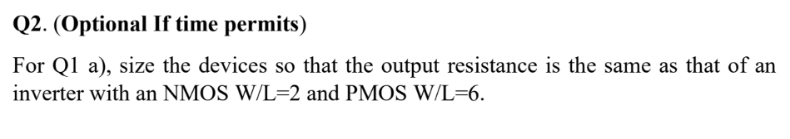
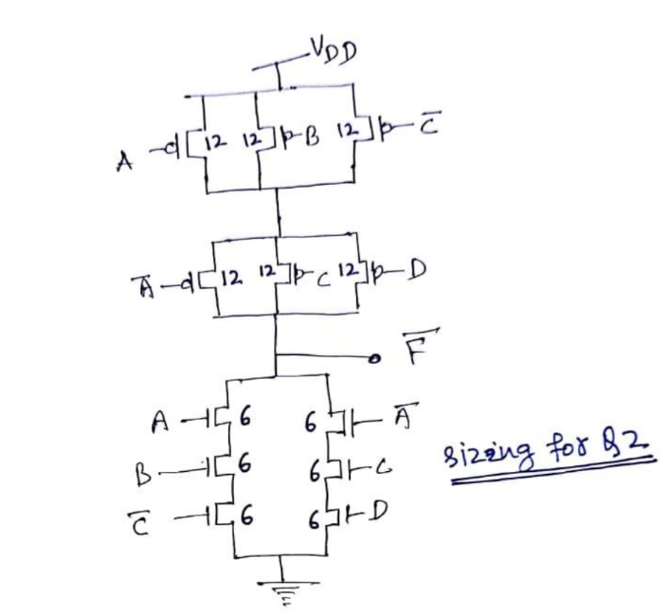

Slide 7
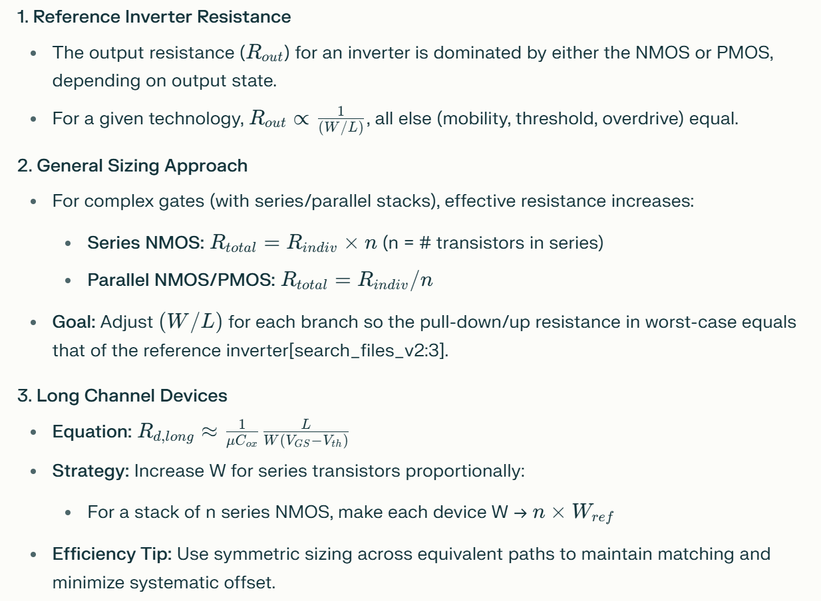
Sizing for Output Resistance Equivalence

Slide 8
